Slide 1


Slide 2
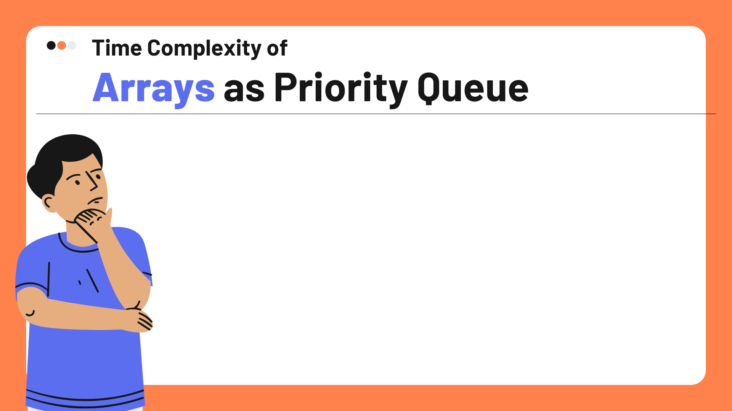
Enqueue : O(1)
Dequeue : O(V)
Update : O(1)
Update every Edge
Enqueue & Dequeue every vertex
O( V(1+V) + E )
= O ( V+V² + E)
= O(V² + E)

Slide 3

Enqueue : O(V)
Dequeue : O(log n)
Update : O(log n)
Dequeue every vertex
Initial Heapify
Update every Edge
O(V+ VlogV + ElogV )
=O((V+E)logV)

Slide 4

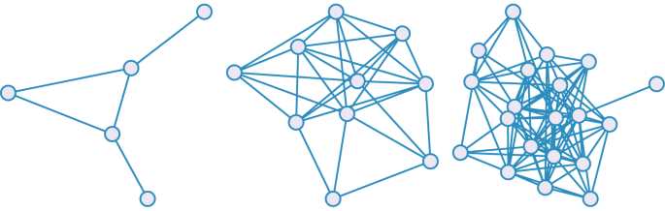
Our Hypothesis
Implementation with adjacency lists and MinHeap, will perform better when the graph is sparse.
After a certain threshold, the implementation with adjacency matrix and array priority queue, will perform better, as the graph becomes dense.
This will occur at the threshold :
VlogV + ElogV < V² + E
ElogV - E < V² - VlogV
E(logV - 1) < V(V - logV)
E <
V(V - log₂V)
log₂V - 1

Slide 5
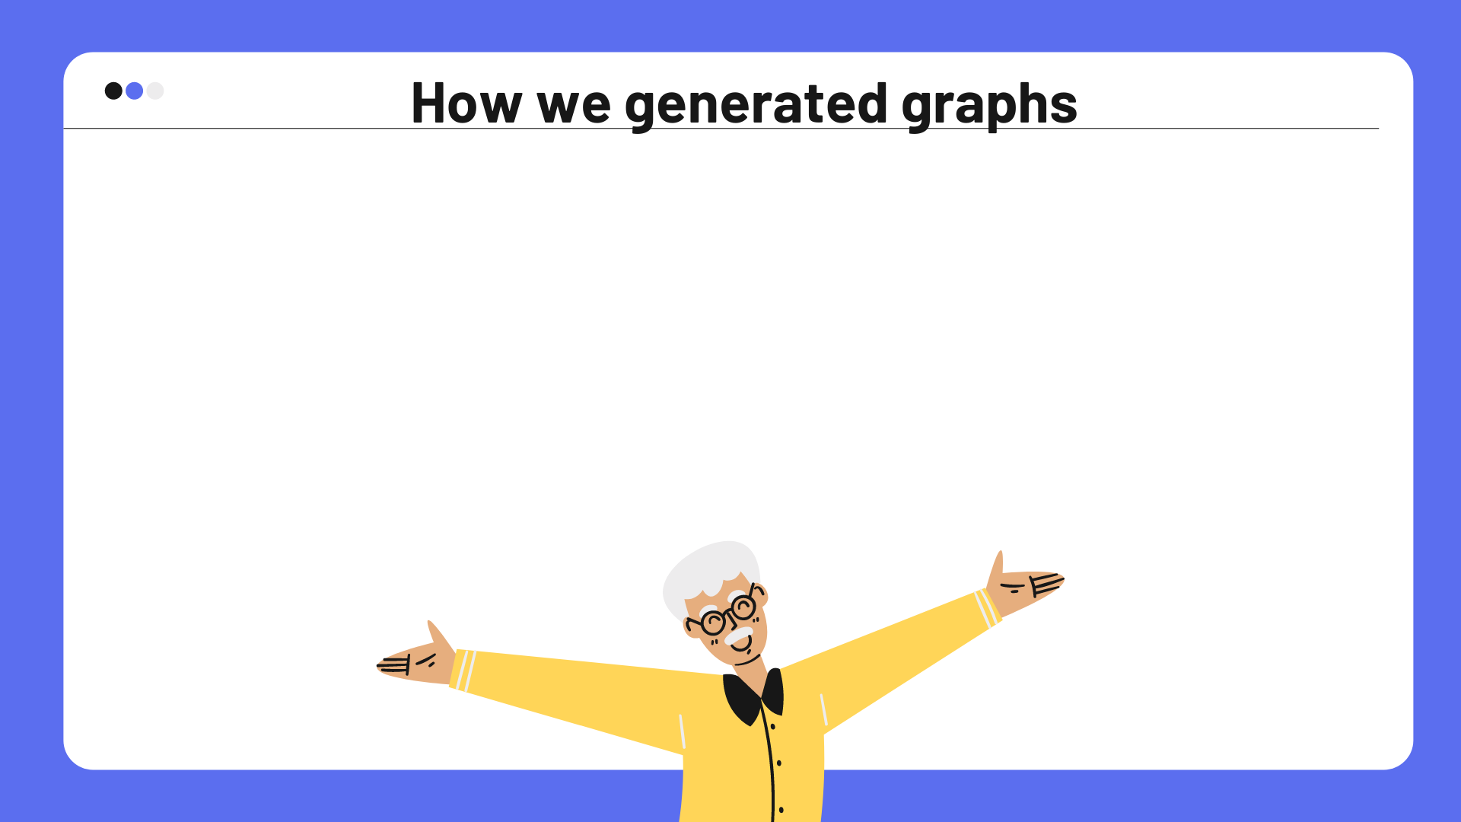
We used the Erdős–Rényi model to generate graphs.
An ER graph on a set of V vertices is a random graph which connects every pair of vertices {i, j} with an independent probability p.
However, we did not allow self loops to exist.

Slide 6

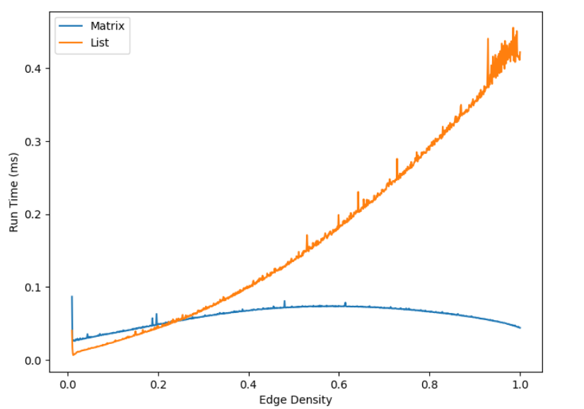
Our Findings
Varied graph density by fixing V = 100 and increased the number of edges V ≤ E ≤ V(V-1)
Intersection occurs at
E ~ 2215
Theoretically, E~1700

Slide 7
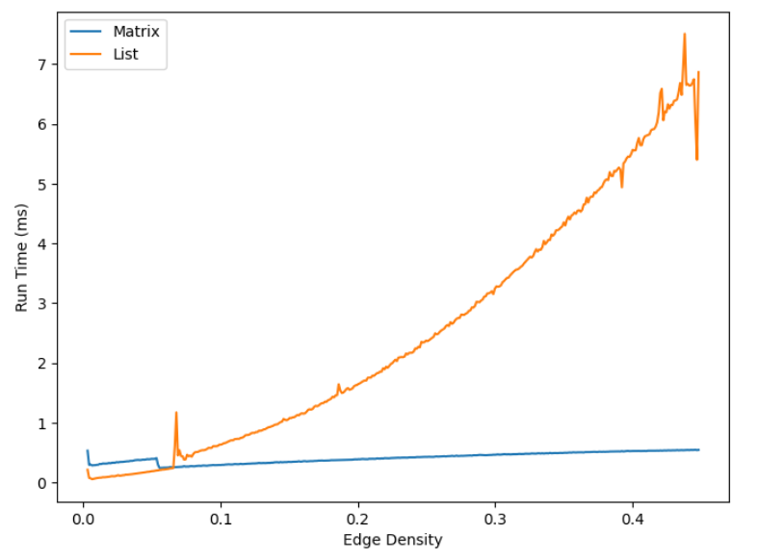
Our Findings
Varied graph density by fixing V = 300 and increased the number of edges V ≤ E ≤ V(V-1)

Slide 8

Hypothesis:
The best case would be when the graph is minimally connected ie. has V-1 edges
Hypothesis:
The worst case would be when the graph is fully connected ie. has V(V-1) edges

Slide 9
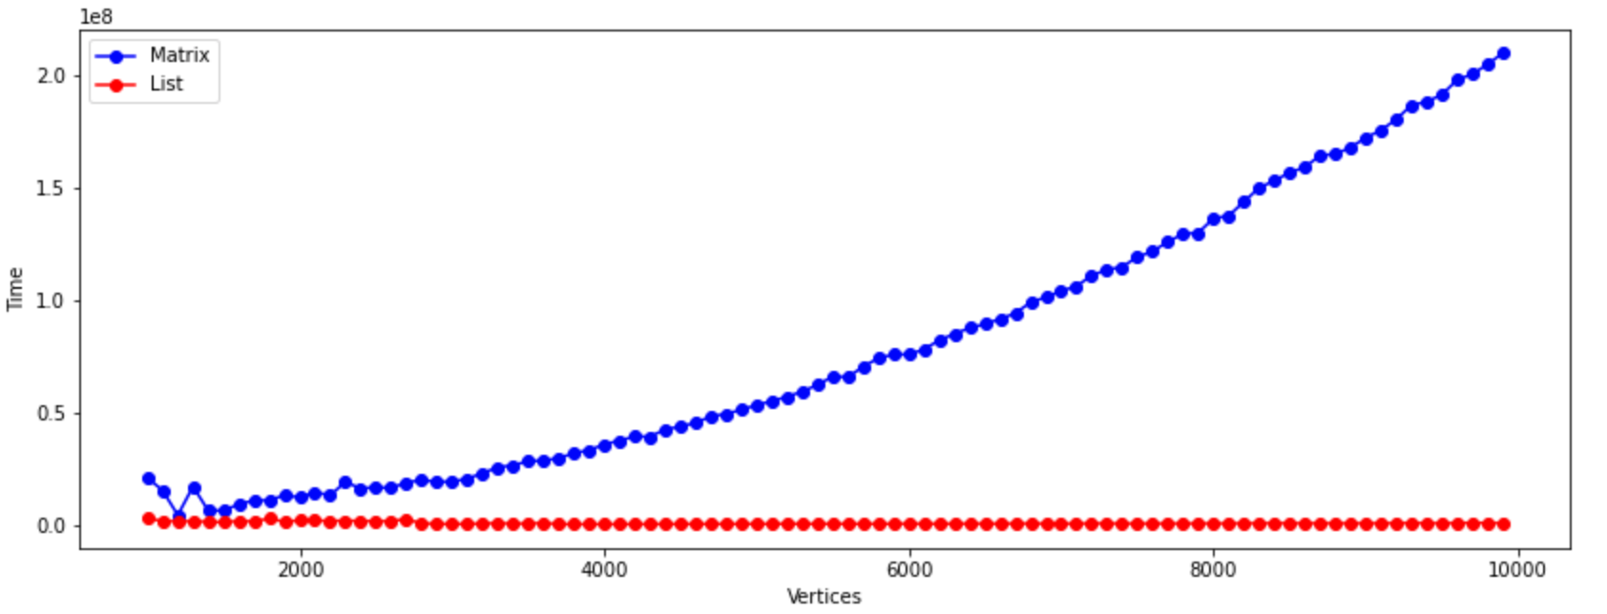
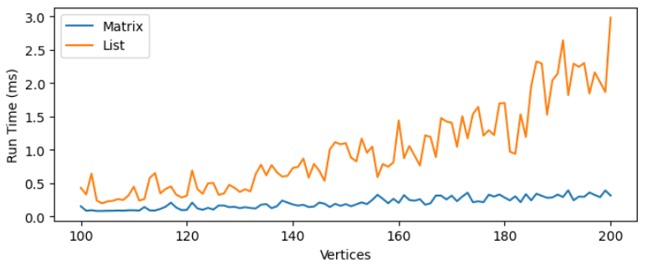

Slide 10


Slide 11
Findings for Best/Worst Case Analysis

